Slide 1


Team 4
Beijing Air Pollution Time Series Forecasting
Amit Anand Kumar- Aak20008
Akash Deep Konda- Kad21008
Chaitanya Bandaru- Chb21009
Lohith Krishna Pogala- Lkp21003
Venkata Karteek Thota- Vet21001
Sathwik Pendyala- Sap21007

Slide 2






Team Introduction
Amit Anand Kumar
Akash Deep Konda
Chaitanya Bandaru
Lohith Krishna Pogala
Venkata Karteek Thota
Sathwik Pendyala

Slide 3
Agenda
Introduction
Problem Statement
Data Description
Exploratory Data Analysis
Modelling
Model Comparison
Results
Recommendations

Slide 4
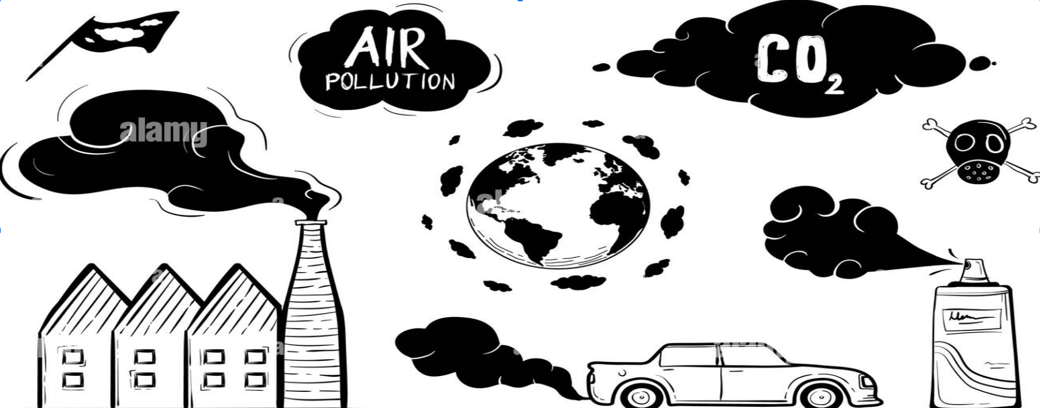
Introduction
Air pollution is one of the most serious issues that many countries are dealing with
It directly contributes to cause Health Problems, Global warming and can create a potential for certain disasters
Beijing is the world’s most populous city with an estimated population of over 21 million people.
The main reason for Beijing pollution has been caused by increased vehicle emissions caused by increased population.
Beijing and a substantial part of China has been experiencing chronic air pollution in last decade
In the previous decade, Beijing and a large part of China have been experiencing chronic air pollution.
Beijing has extreme climate conditions, the temperature can increase upto 42°C and can drop down till -27°C

Slide 5
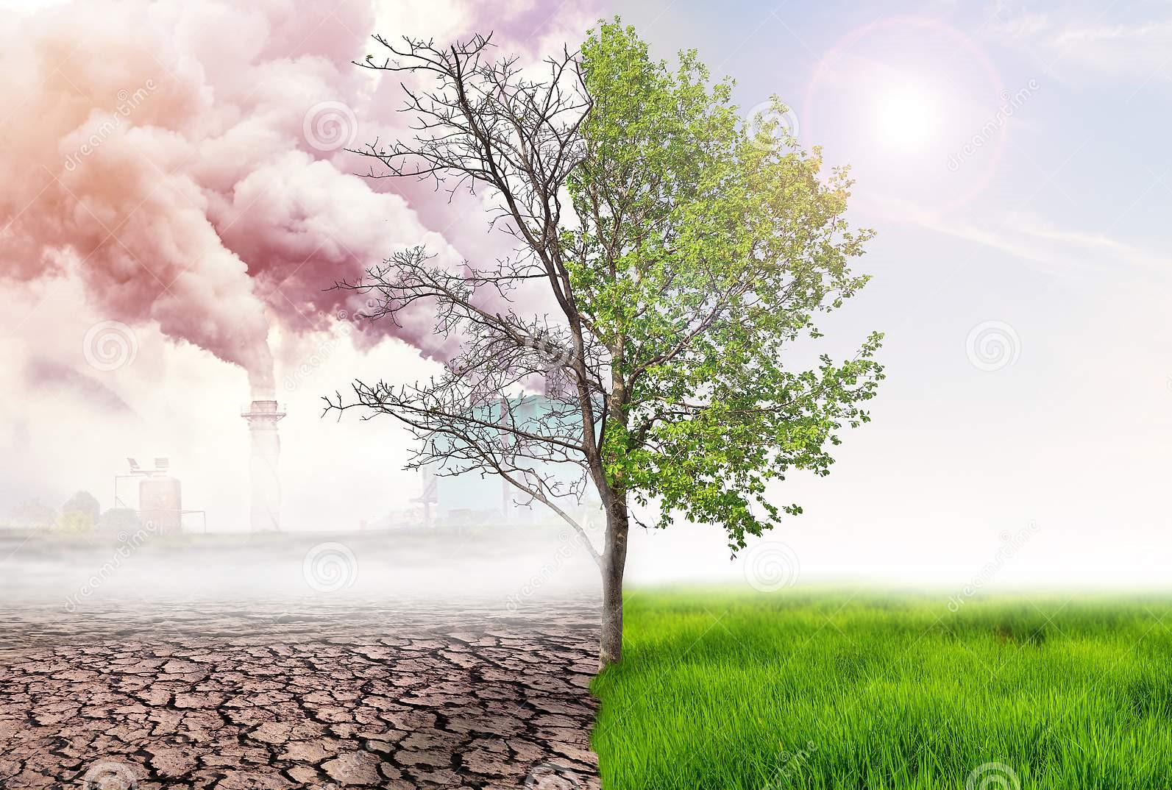
Introduction
This raises the need for accurate forecasting of pollution levels, in order to take precautions before things get disastrous
This helps in:
Avoiding the factors that are causing seasonally to avoid spikes in pollution rates.
Disaster mitigation
Creating an early warning system

Slide 6
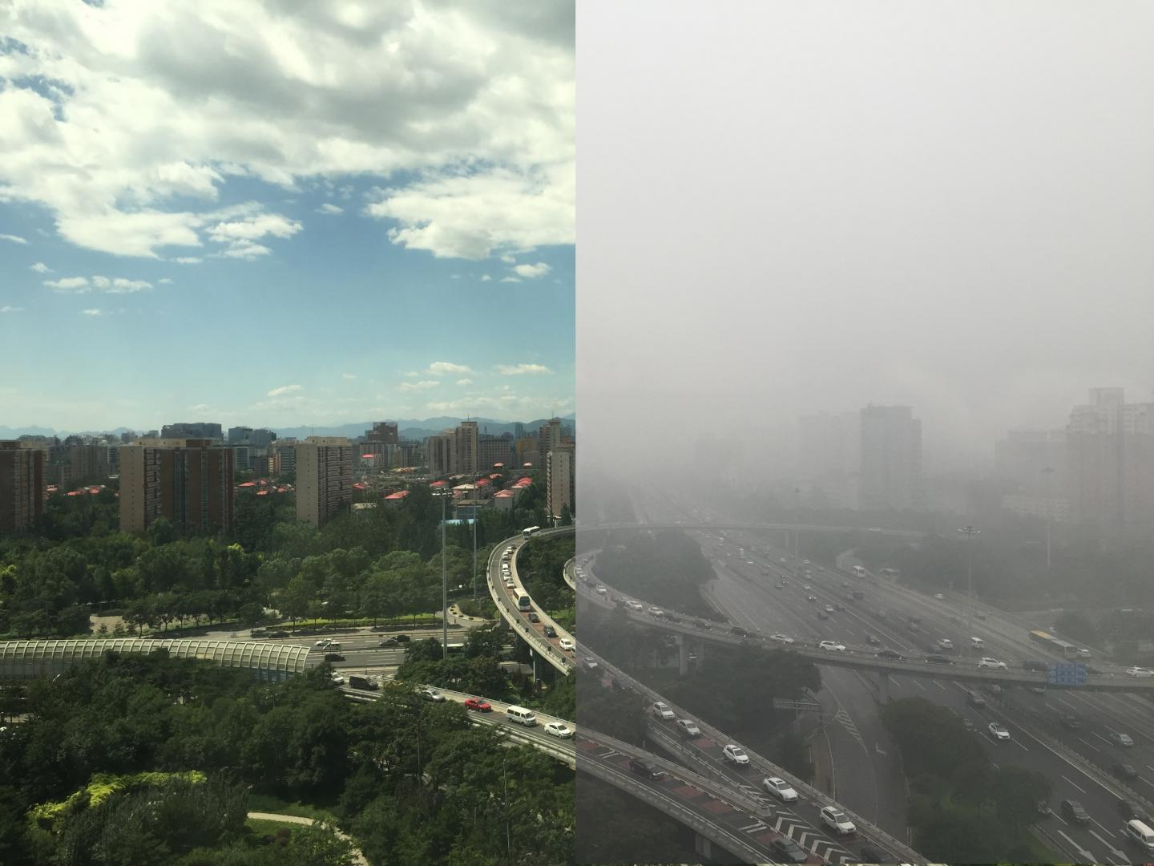
Problem Statement
The pollutant that affects people the most is particulate matter, usually abbreviated as PM and used as a measure of air pollution.
Although particles with a diameter of 10 microns or less (≤PM10) can penetrate and embed deep in the lungs, the ones that are more harmful to health are those with a diameter of 2.5 microns or less (≤PM2.5).
Our primary goal is to come up with a model given the weather conditions and pollution for prior days, we can forecast the pollution for the upcoming days.
Low PM
High PM

Slide 7
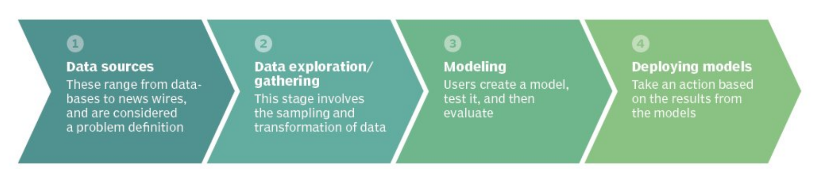
Our Approach:
Notes:
The first thing we do while doing a modeling project is to collect the data. So here in order to forecast the pollutions levels of Beijing, we collected the data from the Beijing official
pollution website. Then we did the data preprocessing part which will be explained in the subsequent slides.
Then we did the data modeling, in which we tried various model by changing the all the parameters.
Then we evaluated the model with the error metrics like R2, RMSE.
And then Based on the models we came up some insights and recommendations.

Slide 8
What we performed:
Process the dataset we have and make it model-ready
Finding Factors that influence increase in pollution content leveraging data mining
Predicting the future pollution rates using time series
Come up with an accurate approach to forecast the pollution
Exponential smoothing of the best model to further enhance the accuracy
Provide business insights and recommendations
Notes:
After collection of data we have processed the data by using python and made it model ready
Then we found which factors are highly correlated and which factors are highly dependent on each other by drawing various visualisations in tableau and SAS.
Then we predicted the future pollution rates using time series using SAS
Then we came up with best model by changing the all the parameters in SAS.
Then we did exponential smoothing to find the best model to increase the accuracy further.

Slide 9
Data Description
What all data do we need to forecast pollution levels?
How is the temperature?
Air Quality?
Moisture content in Air?
Changes in Weather like
How much is the rain?
How long is it snowing?
Speed and Direction of wind
How much particulate matter is in the air?
Notes:
So in order for us to predict the pollution levels we wanted to find how pollution levels are varying w.r.t other features.
What is the air quality due to the high pollution levels.
How moisture content is effecting the pollution levels?
Whether rain, snow,wind effecting the pollution or not if effecting in what way?
So these some of the findings which we were interested in and will discuss about them in the subsequent slides.

Slide 10
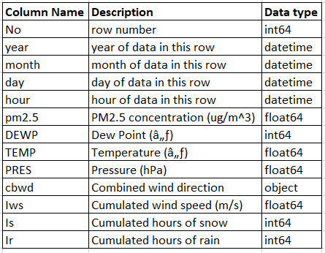
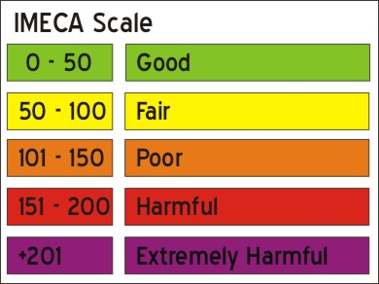
Data Dictionary
Data period: 01/01/2010-12/31/2014
Beijing dataset: https://archive.ics.uci.edu/ml/datasets/Beijing+PM2.5+Data
Given the weather conditions and pollution levels for prior days, we can forecast the pollution for the upcoming days
Notes:
So here our target variable is pm2.5.
The IMECA scale which you are seeing is used to show the level of pollution and the level of risk that represents to the human health. If the pm 2.5, our target variable value is >100 then we can consider the air quality as poor.

Slide 11
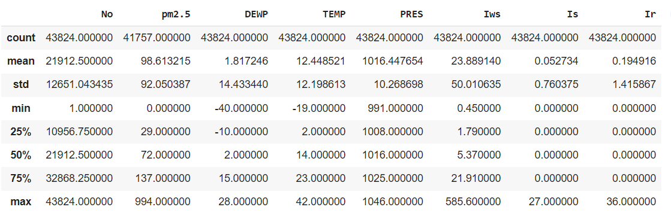
Data Summary Statistics
Notes:
Here we did create the Table which is showing the summary statistics of all the columns in our dataset.
The average pollution level of beijing is 98.6, which is almost in verge of entering into the poor quality category and we also can see that the standard deviation is 92, which is very high that tells us that there are defining factors which are contributing to the pollution levels in beijing.

Slide 12
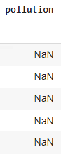
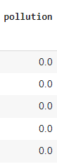
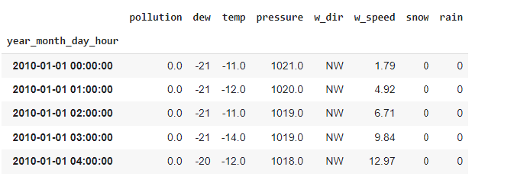
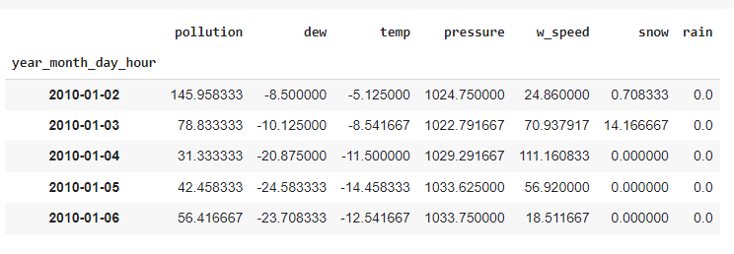
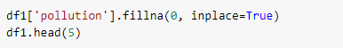
Data Preprocessing
Imputed the null values in the pollution column with Zeros.
Aggregated the data on daily basis from the available hourly data.
Notes:
Here we have done data preprocessing initially by replacing the NaN values with zero, we did that because we had very few data points and we don’t want to lose data points.
The second challenge is that we had hourly wise data of the pollution so we had convert to daily basis in order to come up with better

Slide 13
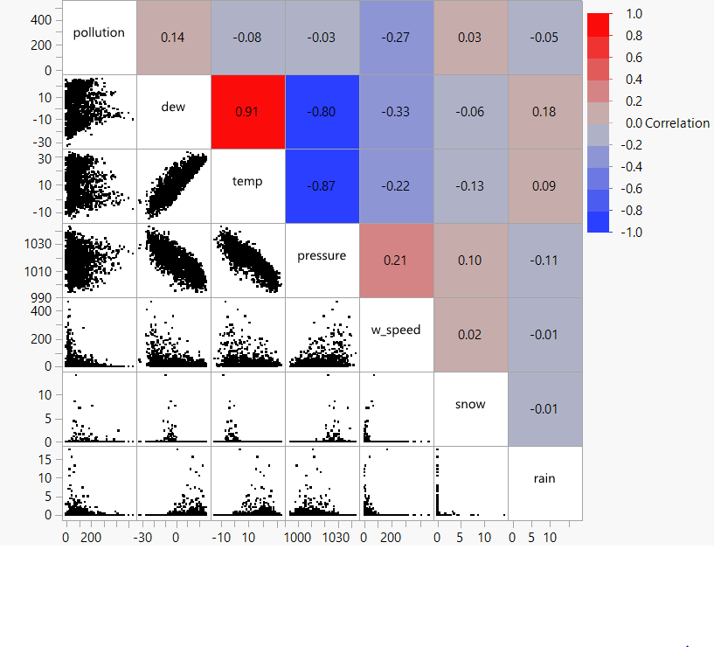
EDA
Correlation plot
Dew and temperature are positively
correlated with each other.
Dew and pressure are inversely correlated.
Temperature and Pressure are inversely
correlated with each other.

Slide 14
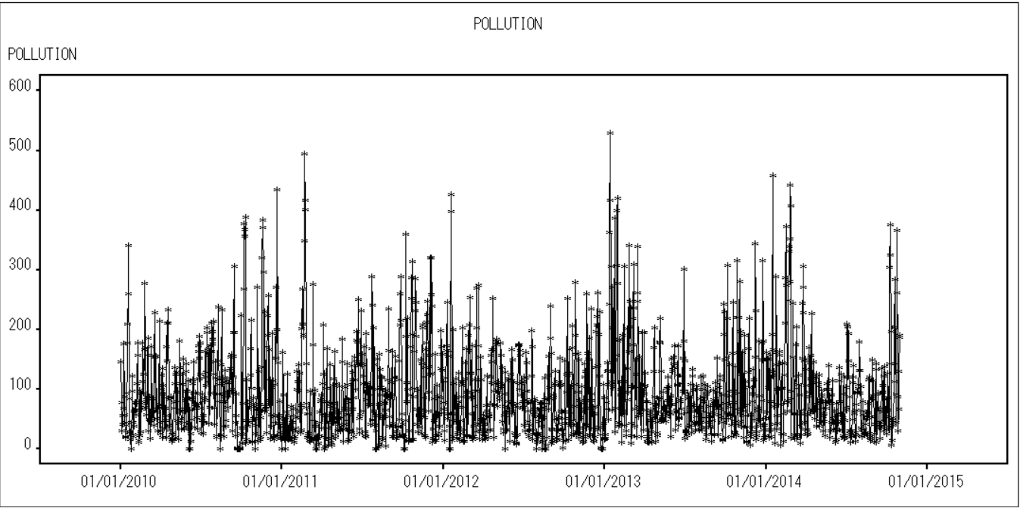
Trend

Slide 15
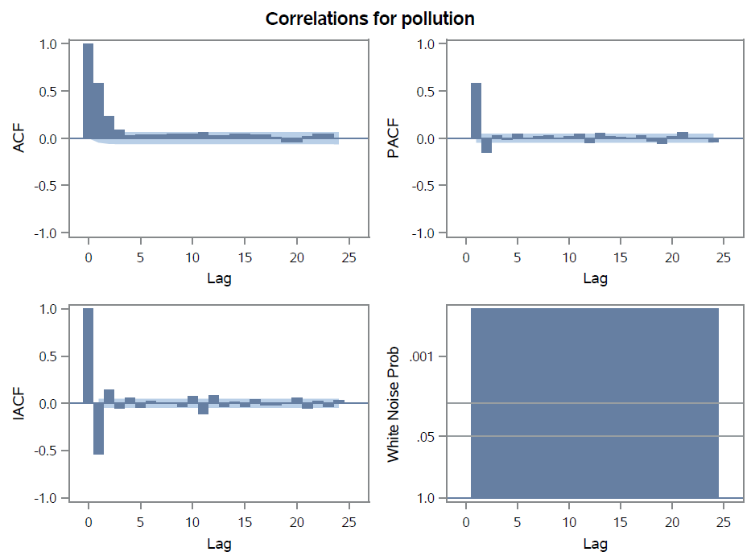
EDA
Correlations and White Noise plots

Slide 16
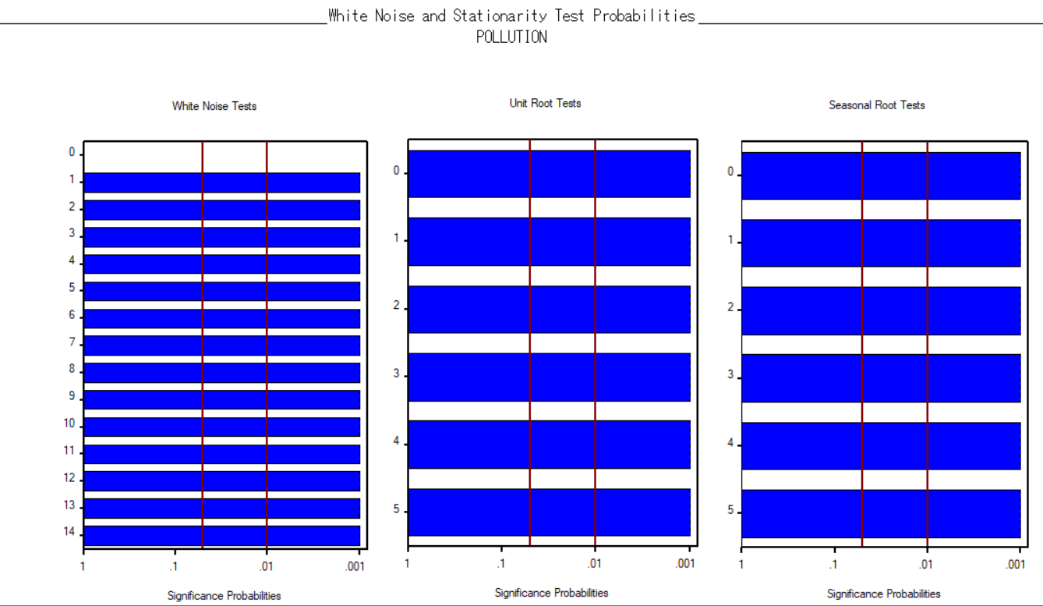
Seasonality

Slide 17
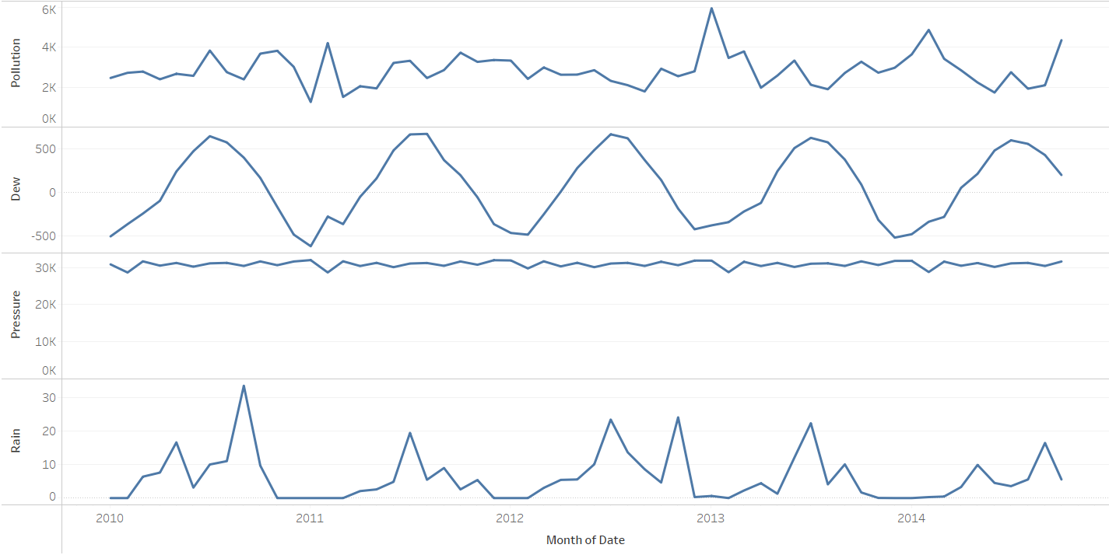
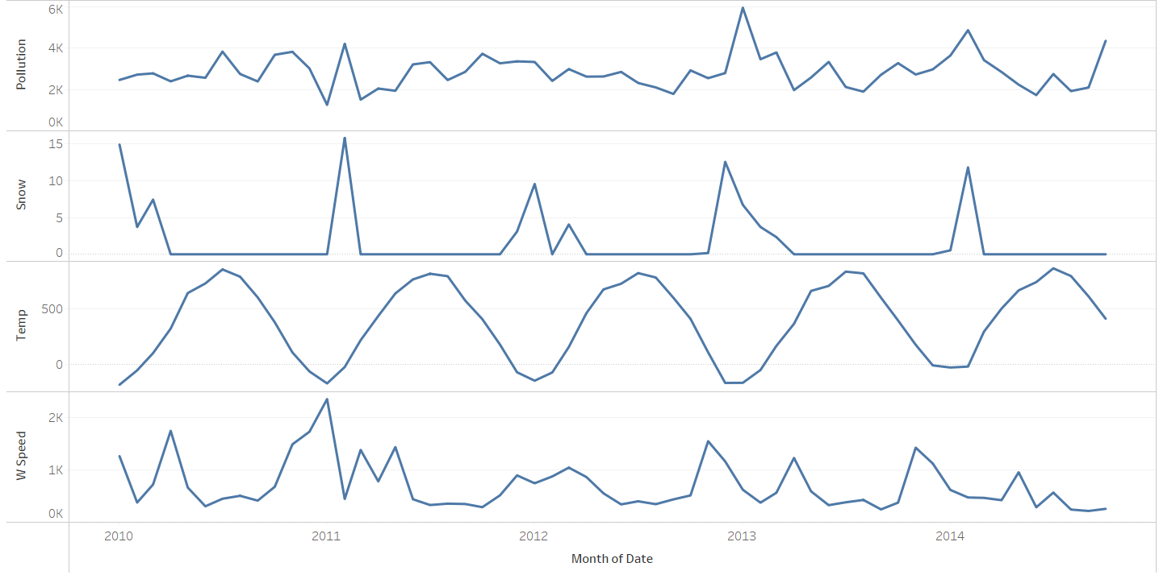
Visualizations
Notes:
There is a seasonality for dew, temperature and wind speed. Which is so obvious with our seasons!

Slide 18
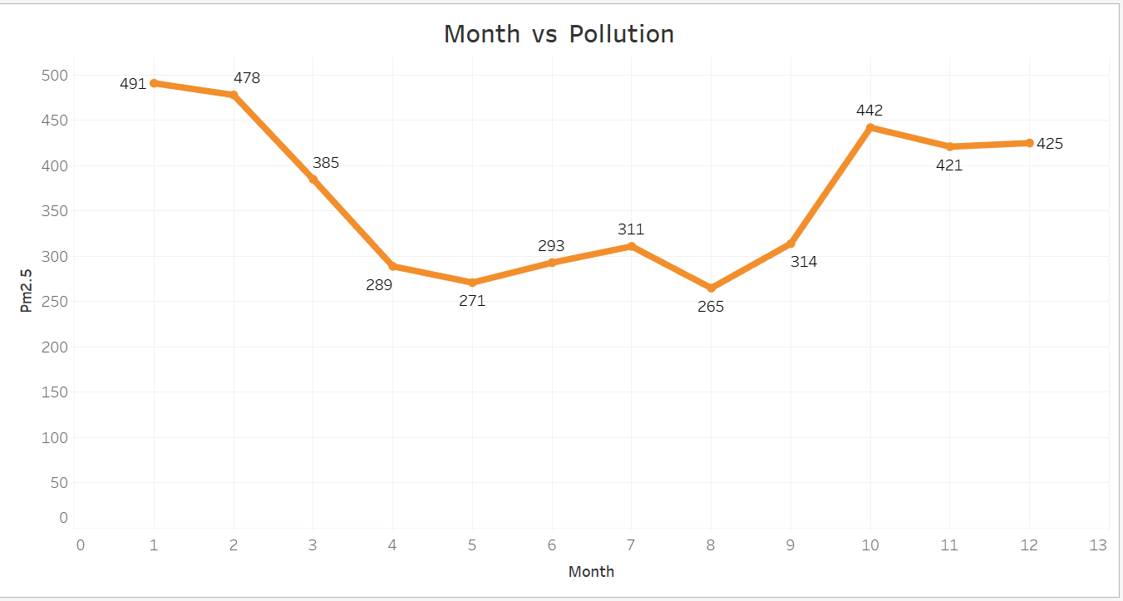
Visualizations
The data shows that the highest pollution levels are observed during the winter months when temperatures are at their lowest.
Notes:
The above plot shows that highest levels of pollution are observed during winter. Since we can see in the graph that pollution levels are high during october, November, december, January and February.

Slide 19
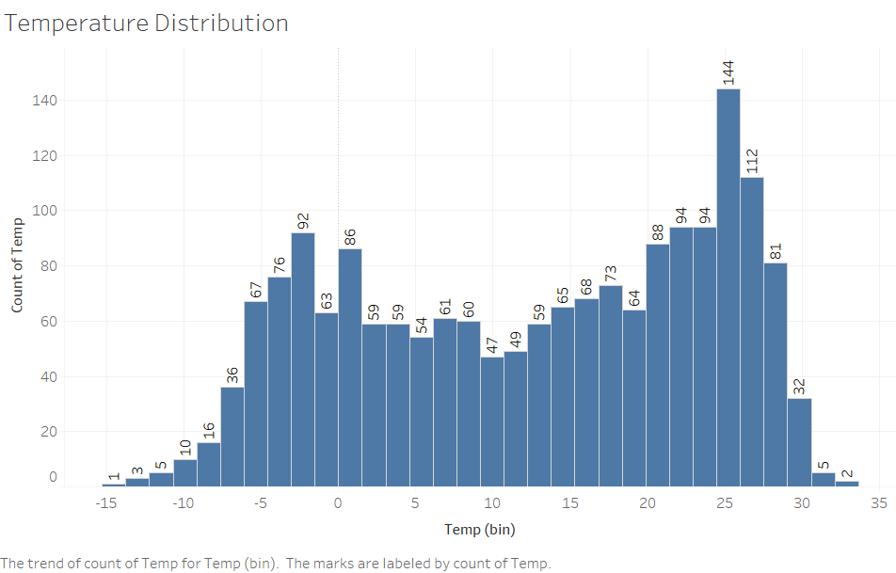
Visualizations
Notes:
The lowest temperature in the beijing is -20 and the highest temperature is 35. We can suggest that based on the findings

Slide 20
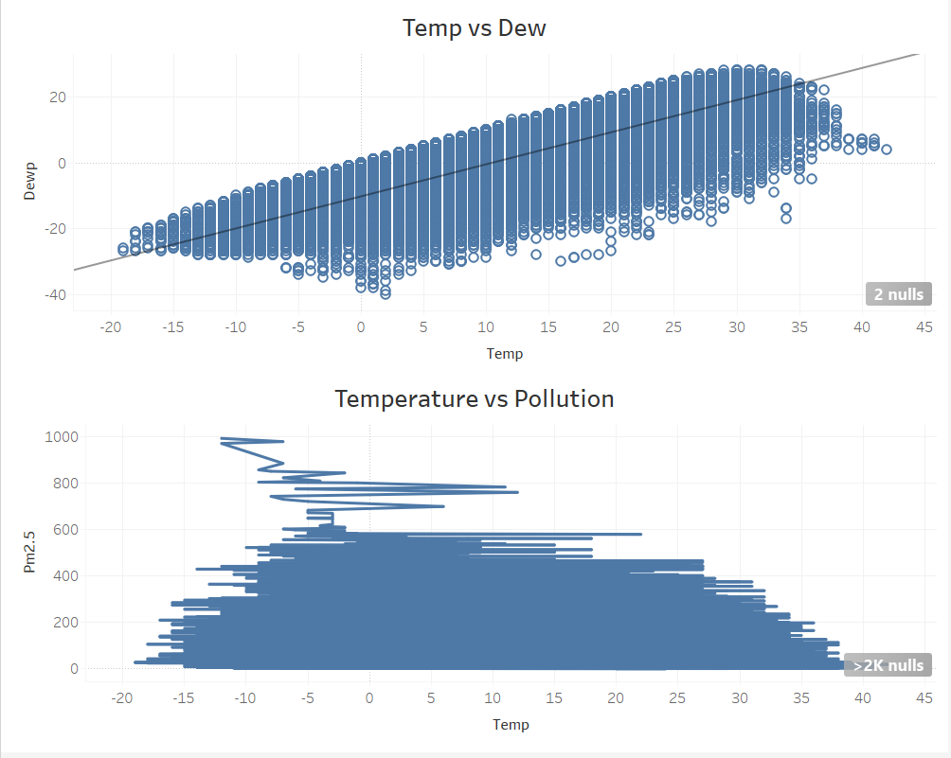
Notes:
In This the above graph here also shows that during low temperatures the pollution levels are very high compared to the high temperatures situations.
The below graph shows that the temperature and dew are highly correlated and we can say that at low dew points the pollution can be very high.

Slide 21
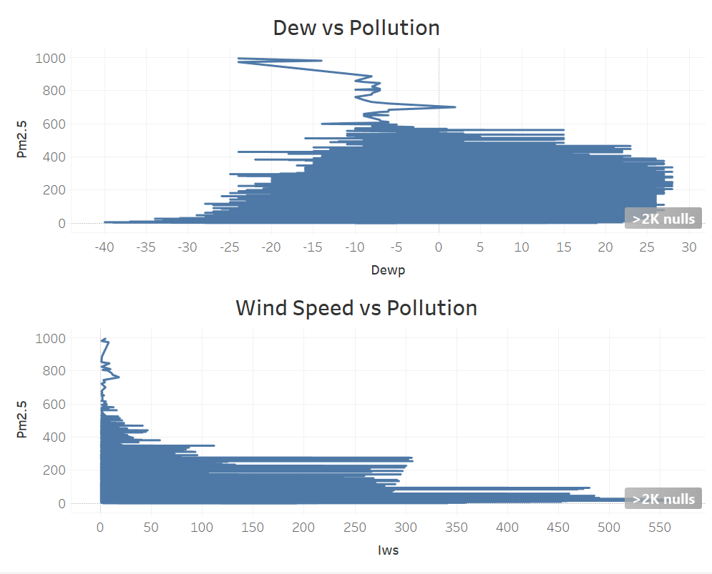
Visualizations
Notes:
As we discussed in the in the previous slide here the above graph tells us that low dew points have high pollution compared to high dew points.
We also came up with an interesting finding that when the wind speed is less the pollution levels are very high.

Slide 22
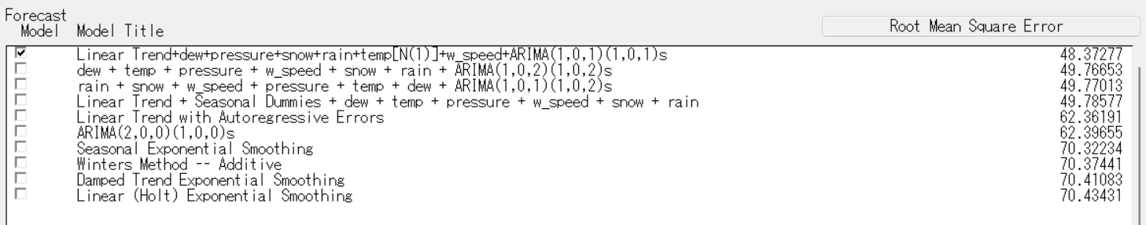
Models Used

Slide 23
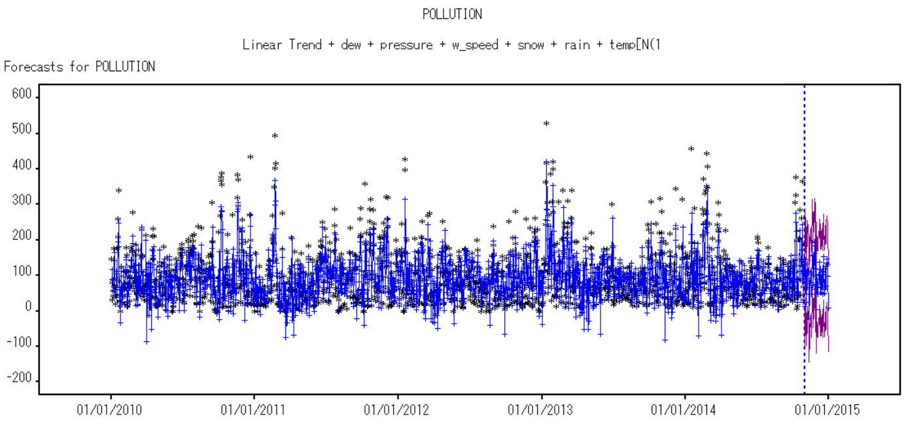
Model Forecast

Slide 24
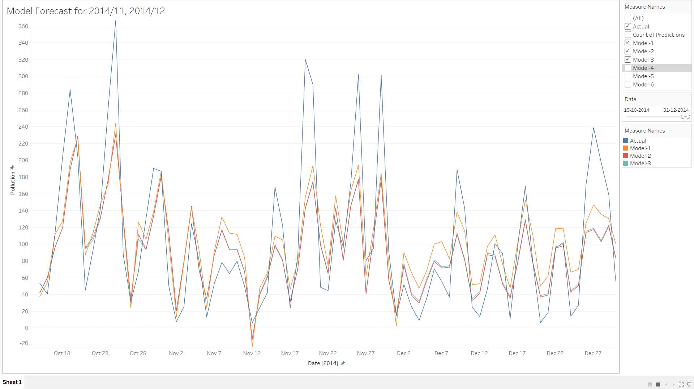
Model Comparison

Slide 25
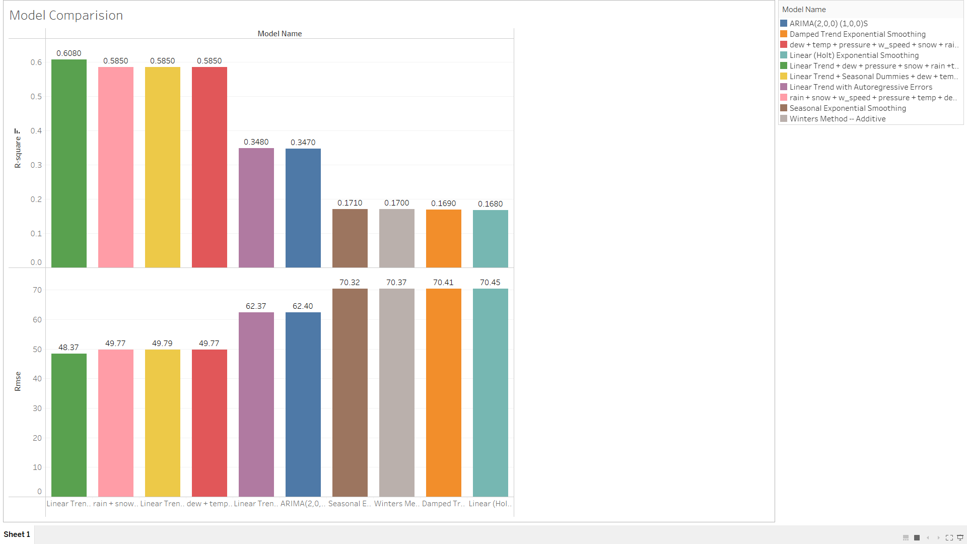
Model Comparison

Slide 26
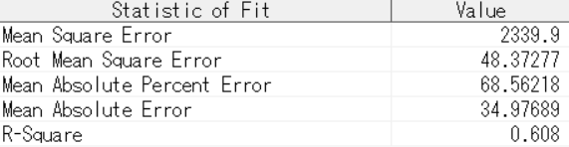
Best Model
Linear trend with seasonal Arima(1,0,1)(1,0,1) having Dew, Pressure, Snow, Rain, Wind speed as Regressors and temperature as point dynamic regressor gave the best performance seeing MAPE and RMSE values.
Notes:
Upon checking for last 2 months data

Slide 27
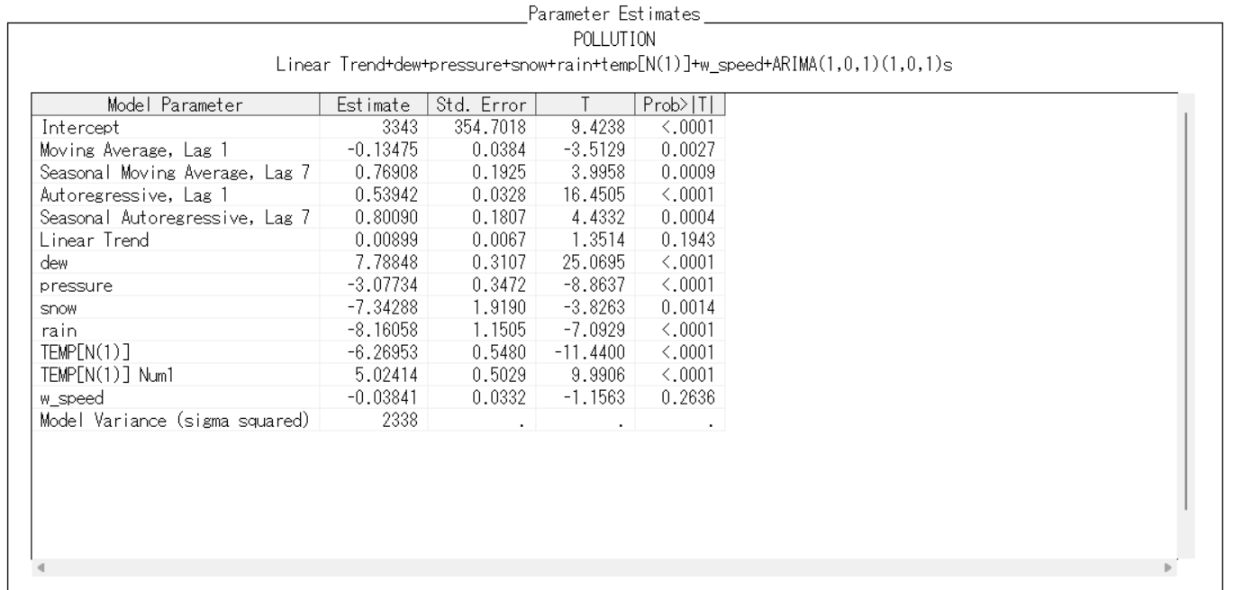
Parameter Estimates for our Best Model
Notes:
Dew has higher parameter estimate in our best model
It is evident that the dew and temperature plays major role in estimating pollution

Slide 28

Insights and Recommendations
Based on past data, we were able to Forecast the PM2.5 levels of next months that could be used to take necessary precautions for that coming period.
From this, we can observe that the pollution levels are high during Jan, Feb, Oct, Nov, Dec which is winter, as there will be much moisture content in the atmosphere. (increased after 2013)
Highest Pollution rate is observed in January every year
We also observed that when the wind speed is low, the pollution is noted to be high, which can be because pollution causing particles are not being spread out of the city
Reducing factory emissions during this period to balance the pollution levels during this period helps safeguard the disasters caused by pollution
During winters, government should come up with innovative ideas like odd-even rule in order to restrict the transportation of vehicles, which in turn helps in reducing the pollution levels.
Improve utilisation of EVs

Slide 29


Slide 30


Slide 31
References
https://royalsocietypublishing.org/doi/10.1098/rspa.2015.0257
https://aqicn.org/city/beijing/
https://www.iqair.com/us/china/beijing
https://arxiv.org/ftp/arxiv/papers/1812/1812.04783.pdf

